Slide 1

Department of Public Health (PH)
Assignment On
Critical Review of my favourite film
Course Code: ENG-102
Course Title: English
Submitted To
NIBADITA CHOWDHURY
Lecturer, Department of public Health
Daffodil International University
Submitted By
Mayesha Mahzabin
Student ID: 232-53-056
Daffodil International University
Date of submission :13/05/2024

Slide 2
October…
It’s not a lovestory,
It’s a story about love

Slide 3

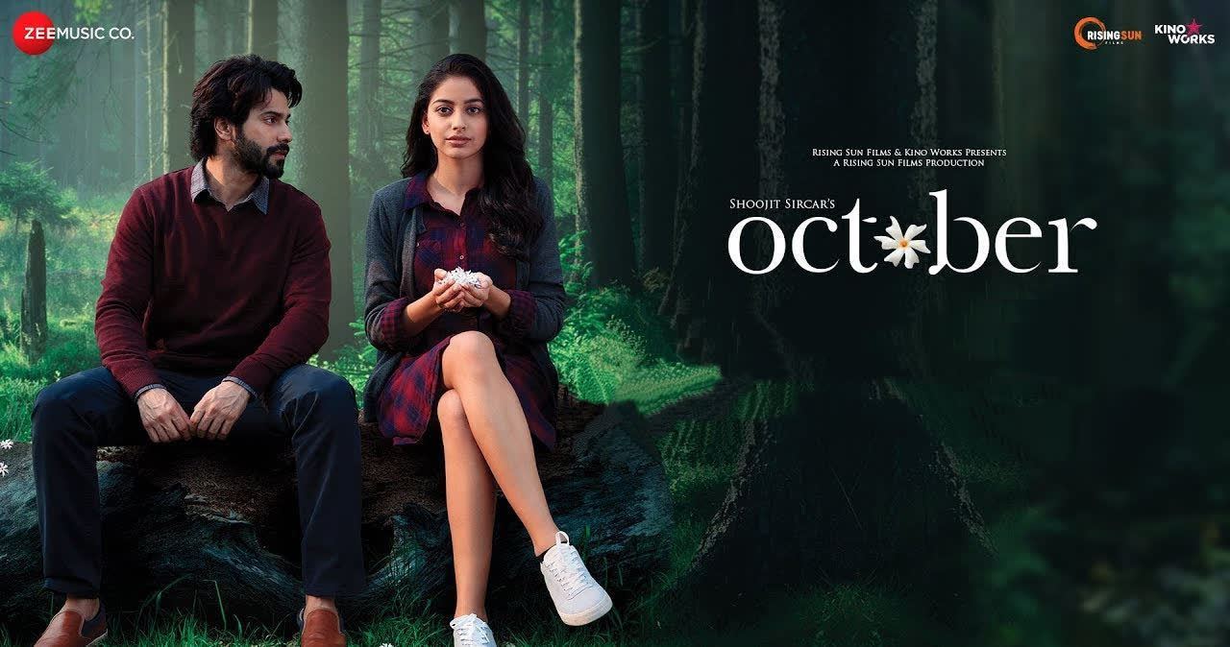
My favourite film:
Name:October
Director:Shoojit Sircar
Release:2018
Genre:Romance/Drama
October,It’s not a lovestory.It’s a story about love.

Slide 4
Genius Director:
A genius director Shoojit Sircar is famous for his unique narrative style. He has created one legendary film before named Piku and he again came back with his new film named October.October film was released in 13th April 2018.Shoojit Sircar is one of my most favourite director.

Slide 5
Why my favourite film?
The reason I like this film so much:
Unique direction.
Exploring deep to the human emotions
Beautiful Cinematography
Beautiful philoshopy
Deep meaning hidden in the movie.

Slide 6
Summary:
The story revolves around two characters named Dan and Sheuli who were quiet opposite.One day in a party Dan wasn’t present at the party so Sheuly asked while sitting on the ralling of the roof.Suddenly she fel down.So Dan wnted to tell her where he was but how to tell as she was in the hospital and so he decides to wait for her being cured and in this waiting process he sacrificed even his carrer.That’s how a bond of pure love developed between them.Dan was a careless person.But Sheuly actually changed him and he started to become more responsible.Although Sheuli died in a few months just like her name Sheuli which is the name of flower Jasmine in bengali which blooms only in October and the flower with the shortest life.
So Sheuli lived a short life but left her smell for the rest of Dan’s life.

Slide 7
Recommendation:
I would highly recommend this movie to those people who want to enjoy a meaningful movie which has an really unique narrative style and a mindblowing cinematography.October is a movie which every cinephile will enjoy.The movie might seem a little bit slow in screenplay for sometime from the starting but after you finish the movie you won’t regret of watching it.

